Slide 1
Capstone Project-4 Online Retail Customer Segmentation Unsupervised Machine Learning
By
Vibha Kumari

Slide 2
Problem statement
To identify major customer segments on a transnational data set.
Data set contains all the transactions occurring between 1st December 2010 and 9th December 2011 for a UK-based and registered non-store online retail.
The company mainly sells unique all-occasion gifts.
Many customer of the company are wholesaler.

Slide 3
Data Set
Invoice No: Invoice number. Nominal, a 6-digit integral number uniquely assigned to each transaction. If this code starts with letter 'c', it indicates a cancellation.
Stock Code: Product (item) code. Nominal, a 5-digit integral number uniquely
assigned to each distinct product.
Description: Product (item) name. Nominal.
Quantity: The quantities of each product (item) per transaction. Numeric.
Invoice Date: Invoice Date and time. Numeric, the day and time when each transaction was generated.
Unit Price: Unit price. Numeric, Product price per unit in sterling.
CustomerID: Customer number. Nominal, a 5-digit integral number uniquely assigned to each customer.
Country: Country name. Nominal, the name of the country where each customer resides.

Slide 4
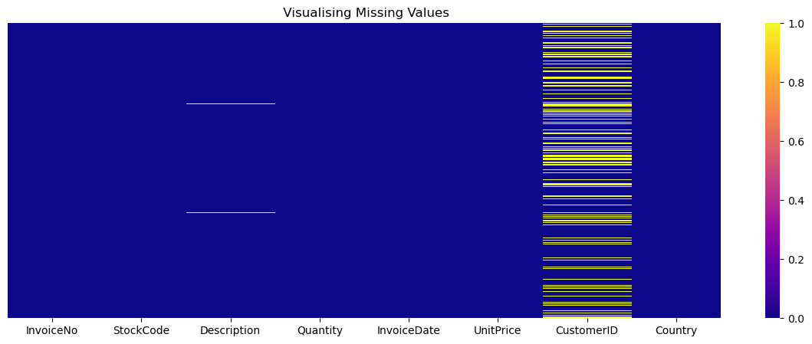
Visualizing null values using heatmap.
Let's check the null values count.
Customer ID 135080
Description 1454
Invoice No 0
Stock Code 0
Quantity 0
Invoice Date 0
Unit Price 0
Country 0
Observations: Missing values in CustomerID and Description columns. CustomerID is our identification feature so if its missing means other wont help us in analysis Dropping that all missing datapoints

Slide 5
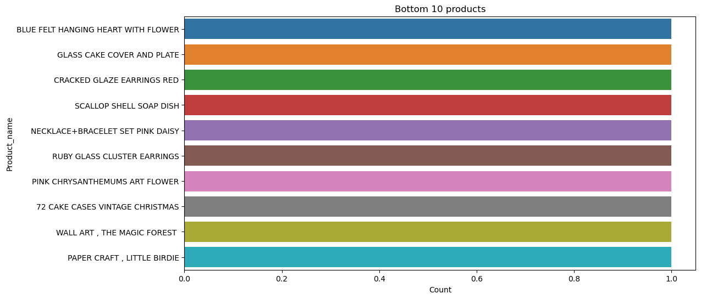
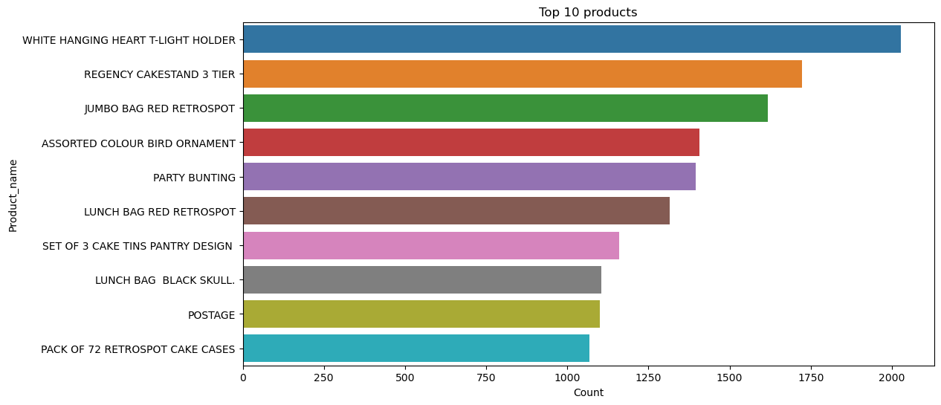
EDA

Slide 6
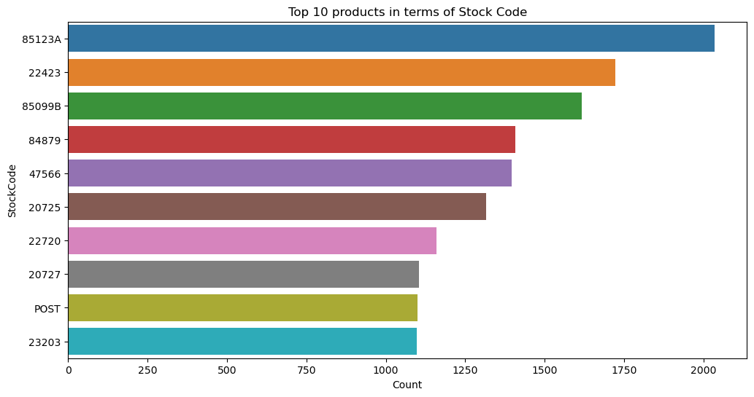
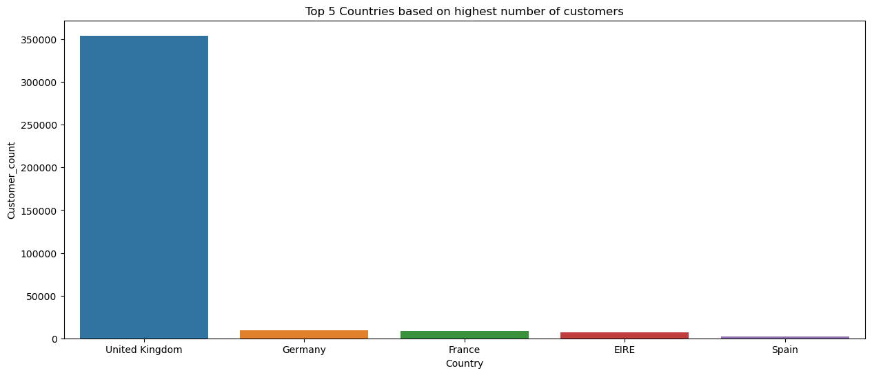
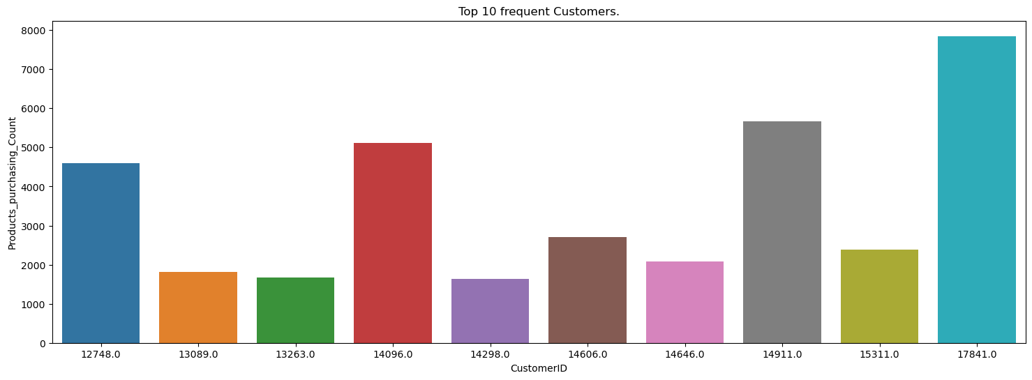

Slide 7
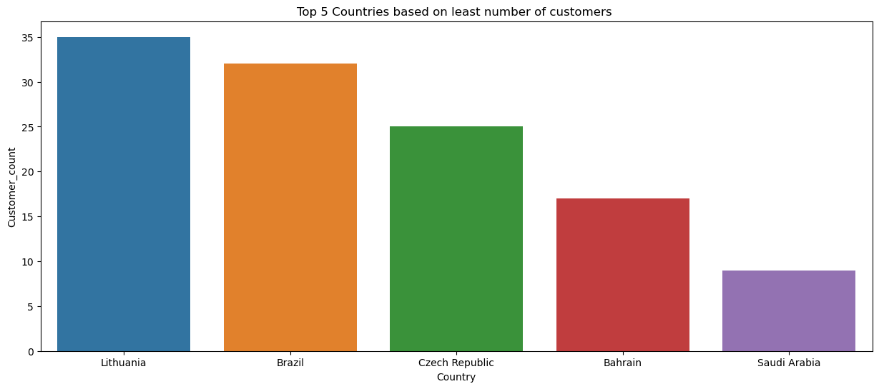
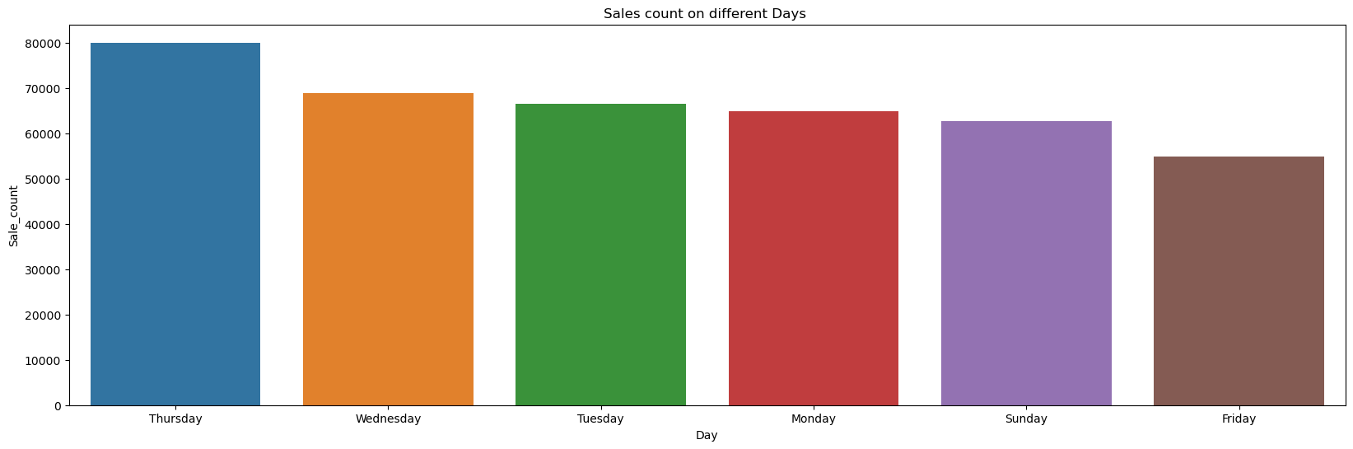
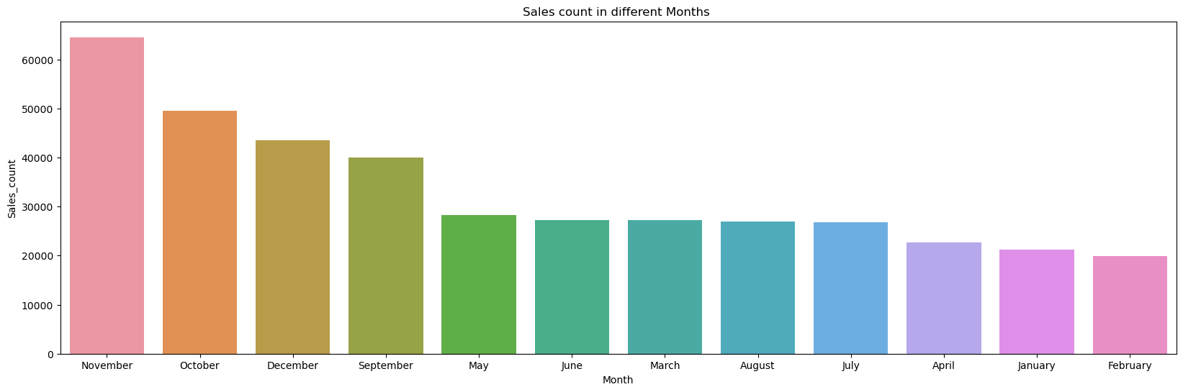

Slide 8
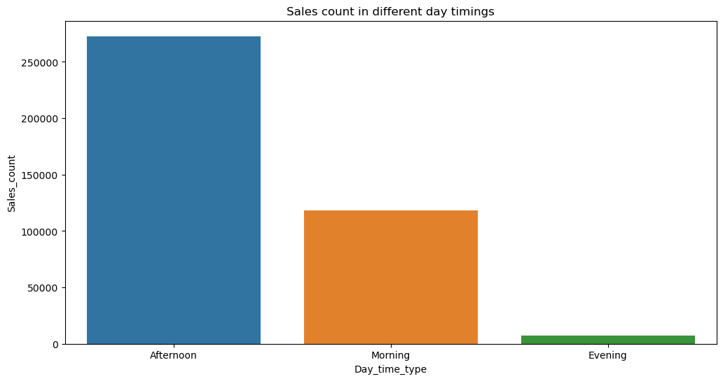
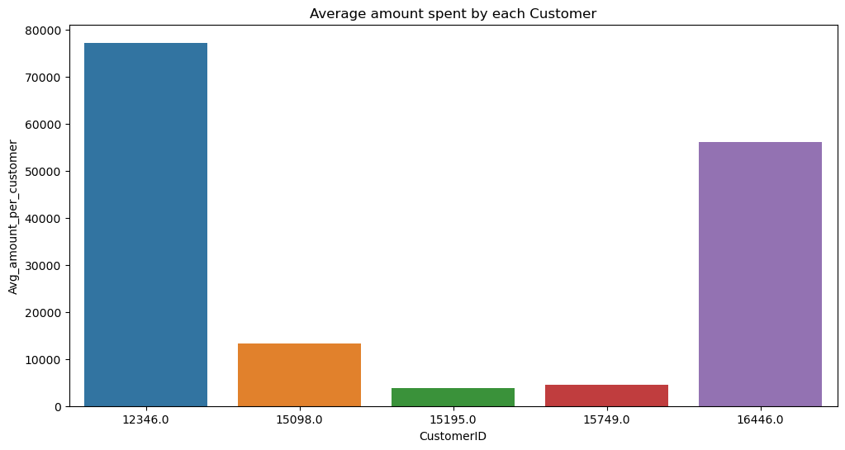

Slide 9
What is RFM?
Why it is Needed?
RFM Analysis is a marketing framework that is used to understand and analyze customer behavior based on the above three factors RECENCY, Frequency, and Monetary.
The RFM Analysis will help the businesses to segment their customer base into different homogenous groups so that they can engage with each group with different targeted marketing strategies
RFM is a method used to analyze customer value.
RFM stands for RECENCY, Frequency, and Monetary.
RECENCY: How recently did the customer visit our website or how recently did a customer purchase? Frequency: How often do they visit or how often do they purchase? Monetary: How much revenue we get from their visit or how much do they spend when they purchase?

Slide 10
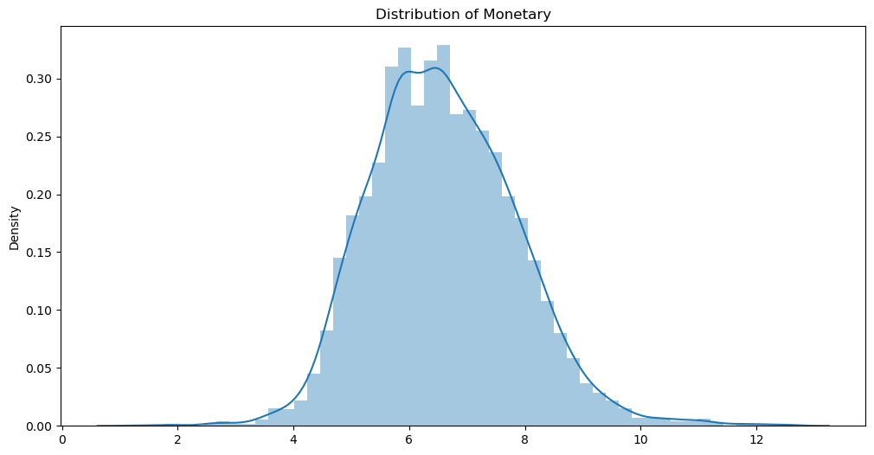
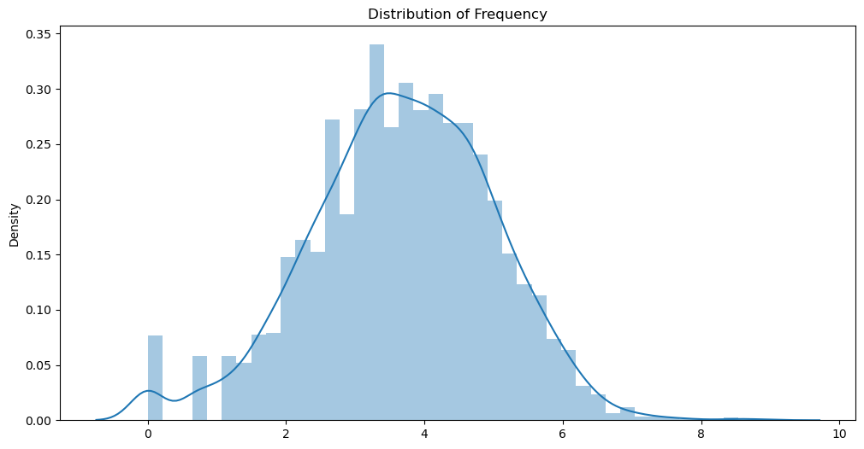
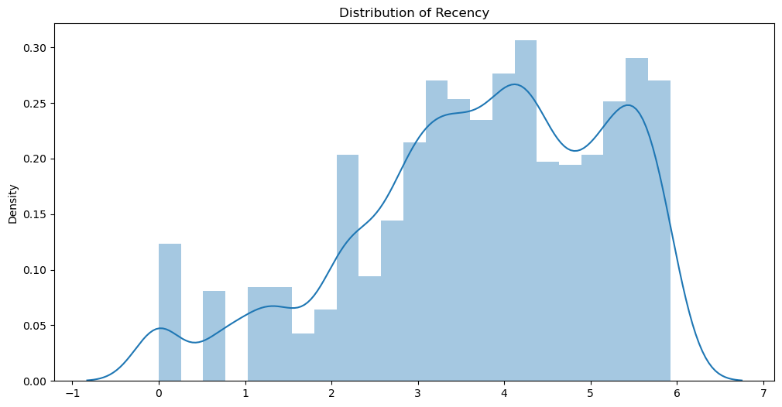
#Perform Log transformation to bring data into normal or near normal distribution

Slide 11
Summary and conclusion
First I did clustering based on rfm analysis , there is 4 clusters based on rfm score
Recency |  |  | Frequency |  |  | Monetary
 | mean | min | max | mean | min | max | mean | min | max | count
RFM_Loyalty_Level
Platinum | 19.412510 | 0 | 140 | 228.559778 | 20 | 7847 | 5255.277617 | 360.93 | 280206.02 | 1263
Gold | 63.376133 | 0 | 372 | 57.959970 | 1 | 543 | 1169.031202 | 114.34 | 168472.50 | 1324
Silver | 126.029562 | 1 | 373 | 24.503568 | 1 | 99 | 583.936944 | 6.90 | 77183.60 | 981
Bronze | 217.261039 | 51 | 373 | 10.955844 | 1 | 41 | 199.159506 | 3.75 | 660.00 | 770
Platinum customers=1263 ( less recency but high frequency and heavy spendings)
Gold customers=1324 (good recency , frequency and monetary)
Silver customers=981(high recency, low frequency and low spendings)
Bronze customers=770 (very high recency but very less frequency and spendings)

Slide 12
Later I implemented the machine learning algorithm to clusters customers
Recency |  |  | Frequency |  |  | Monetary
 | mean | min | max | mean | min | max | mean | min | max | count
Cluster_based_on_freq_mon_rec
0 | 30.989632 | 1 | 372 | 175.251944 | 1 | 7847 | 4033.085330 | 161.03 | 280206.02 | 1929
1 | 140.975509 | 1 | 373 | 24.833126 | 1 | 157 | 469.732795 | 3.75 | 77183.60 | 2409
Cluster 0 has low recency rate but high frequency and monetary. Cluster 0 contains 1929 customers.*
Cluster 1 has high recency rate but very low frequency and monetary . they are not frequent buyers and spends very less money than other customers as mean monetary value is very low. Thus generates less revenue to the retail business*

Slide 13
Conclusion:
Firstly we did clustering based on RFM analysis. We had 4 clusters/Segmentation of customers based on RFM score.
Platinum customers=1263 ( less recency but high frequency and heavy spendings)
Gold customers=1324 (good recency , frequency and monetary)
Silver customers=981(high recency, low frequency and low spendings)
Bronze customers=770 (very high recency but very less frequency and spendings)
.
Cluster 0 has low recency rate but high frequency and monetary. Cluster 0 contains 1929 customers.*
Cluster 1 has high recency rate but very low frequency and monetary . they are not frequent buyers and spends very less money than other customers as mean monetary value is very low. Thus generates less revenue to the retail business*

